Slide 1
NL to SQL Translator Tool for individuals to run unstructured queries against databases
Haipeng Liu
Xingyu Chen

Slide 2
Sprint goal
learn several open-source projects
compare their advantages and disadvantages

Slide 3
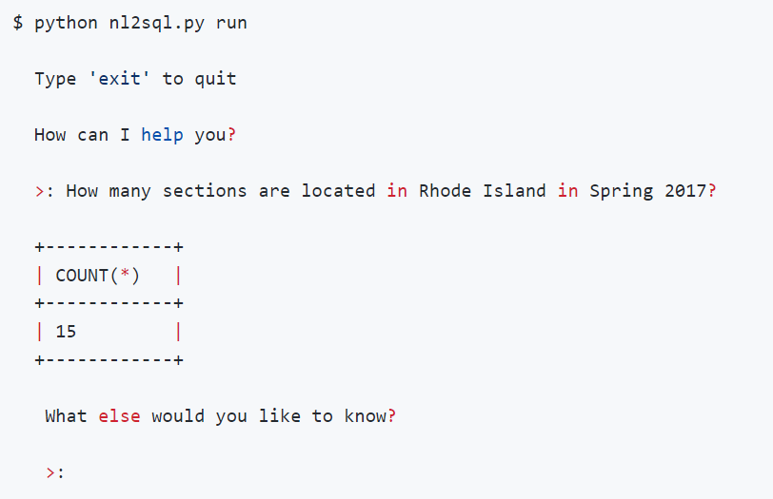
Achievement
Test the function of one well-established translator

Slide 4
Advantages and Disadvantages
Advantages:
User friendly
Easy to understand
Disadvantages:
Requires keywords like “in” and “for” in natural language input
Limited valid input structure

Slide 5
Problems
Some models require large dataset that is hard to get and takes days to train.
Input natural language is sometimes strictly defined in format.

Slide 6
Sprint3 goals
Start developing our own models
Choose suitable dataset

